Slide 1
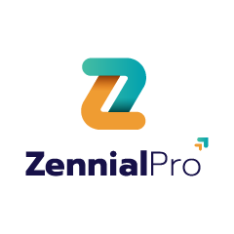
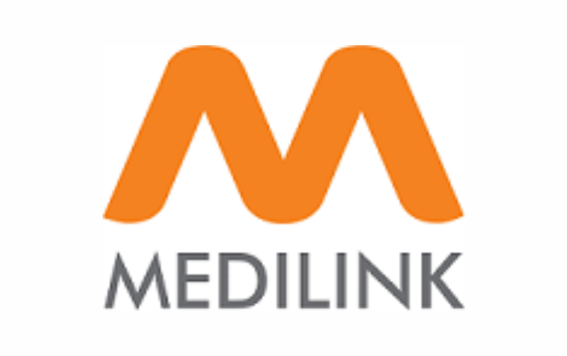
MediLink – Medical Marketplace
FastAPI + MongoDB Based Healthcare Management System

Slide 2



Project Overview
Medilink Pro is a healthcare management system developed using FastAPI and MongoDB.
Provides APIs for Patients and Medicines management
Supports CRUD operations (Create, Read, Update, Delete)
Data stored in MongoDB and JSON for backup
- RESTful endpoints tested via Postman
PPT Medi Link Medical Market Place

Slide 3
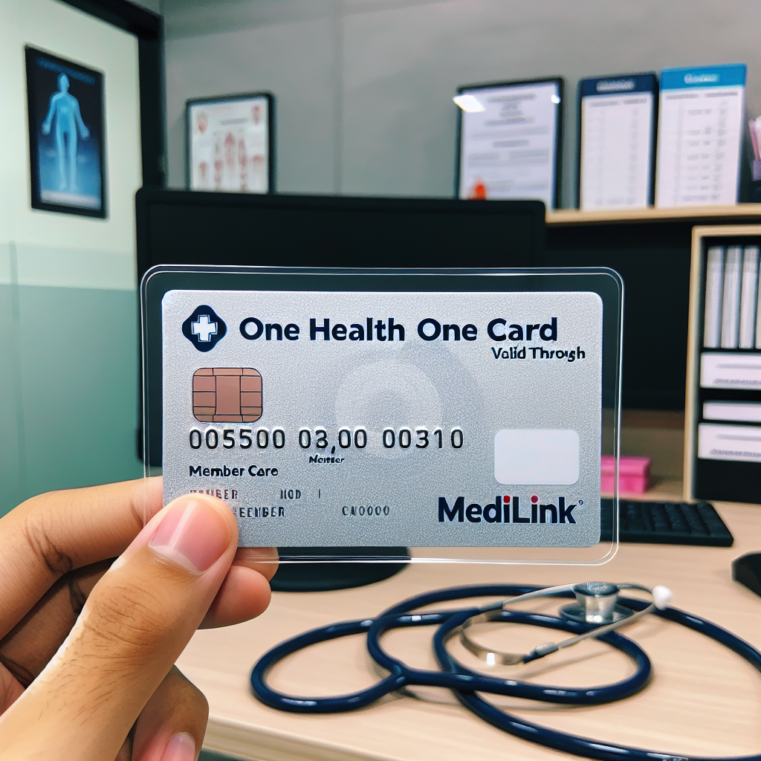
Objectives
• Build a modular, scalable healthcare management API
• Integrate MongoDB for real-time data persistence
• Enable JSON storage for backups
Provide clean and professional API endpoints
• Ensure ease of testing with Postman
PPT Medi Link Medical Market Place

Slide 4

Architecture
The project follows a layered architecture:
• FastAPI for REST API framework
• Motor (async MongoDB driver) for DB integration
• JSON Store for local storage
• Modular routers: Patients & Medicines
• Pydantic models for validation
PPT Medilink Medical Market Place

Slide 5

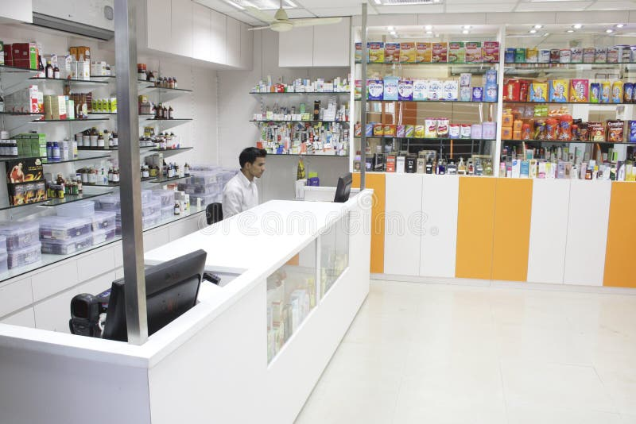
Tools And Technologies
API End Points
• FastAPI (Backend Framework)
• MongoDB (Database)
• Motor (Async MongoDB driver)
• Pydantic (Data validation)
• Postman (API Testing)
• Git & GitHub (Version Control)
• Python 3.11 (Programming Language)
Patients:
- POST /api/patients → Create patient
- GET /api/patients → Get all patients
- GET /api/patients/{id} → Get patient by ID
- PUT /api/patients/{id} → Update patient
- DELETE /api/patients/{id} → Delete patient
Medicines:
- POST /api/medicines → Create medicine
- GET /api/medicines → Get all medicines
- GET /api/medicines/{id} → Get medicine by ID
- PUT /api/medicines/{id} → Update medicine
- DELETE /api/medicines/{id} → Delete medicine
a
PPT Medilink Medical Market Place

Slide 6
Why MediLink?
Traditional systems are fragmented.
MediLink unifies Patients, Doctors, Pharmacies in one secure digital marketplace.

Slide 7
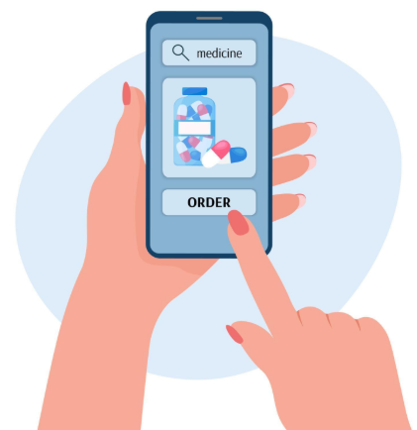
User Roles
Patient → Browse medicines & place orders
Doctor → Create prescriptions
Pharmacy → Manage medicines
Admin → Manage roles & reports

Slide 8

Use Case – Patient
Register & login
Browse medicines
Place orders
Track status real-time

Slide 9
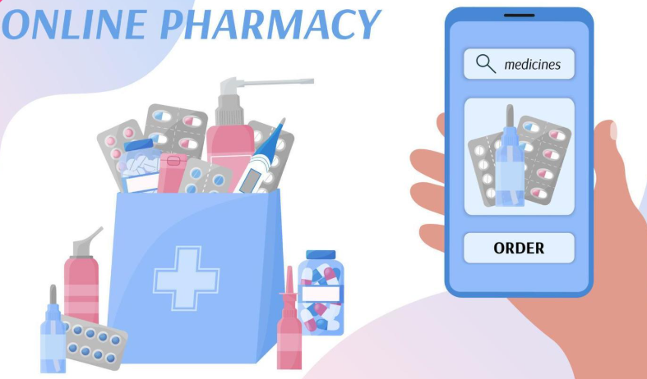
Use Case – Pharmacy
Add medicines
Update stock & pricing
Manage patient orders
Generate sales reports

Slide 10
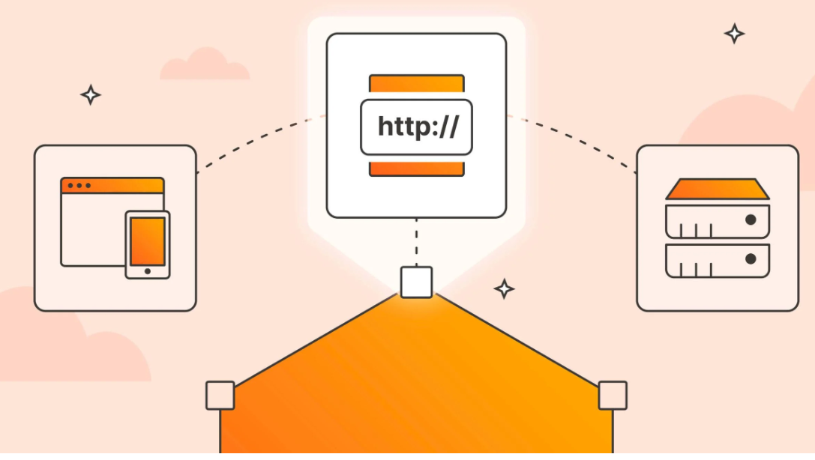
API Endpoints – Overview
Auth: Register, Login
Users: Profile
Medicines: Add, Update, List
Orders: Place, Track

Slide 11
Auth APIs
POST /auth/register → Register user
POST /auth/login → Login & get token

Slide 12
User APIs
GET /users/me → Get profile
GET /users/ (admin only) → List users

Slide 13


Medicines APIs
POST /medicines/ → Add medicine
GET /medicines/ → List medicines
PUT /medicines/{id} → Update
DELETE /medicines/{id} → Delete

Slide 14
Security
JWT Authentication
Role-based access control
Password hashing
Secure DB connections

Slide 15

Benefits
Scalable
Digital healthcare adoption
Secure & compliant
Easy integration for hospitals & pharmacies

Slide 16

Real Life Example
Scenario:
- Patient orders medicine
- Doctor verifies prescription
- Pharmacy confirms & delivers
- Admin monitors

Slide 17

Future Scope
Billing & Insurance integration
AI-driven prescription analysis
Mobile apps
Multi-language support
Doctors registartion

Slide 18

Conclusion
MediLink is a complete healthcare marketplace platform.
Secure, scalable, and ready for real-world use.

Slide 19
Thank You

